Slide 1
League of Legends

Slide 2
LOL

Slide 3
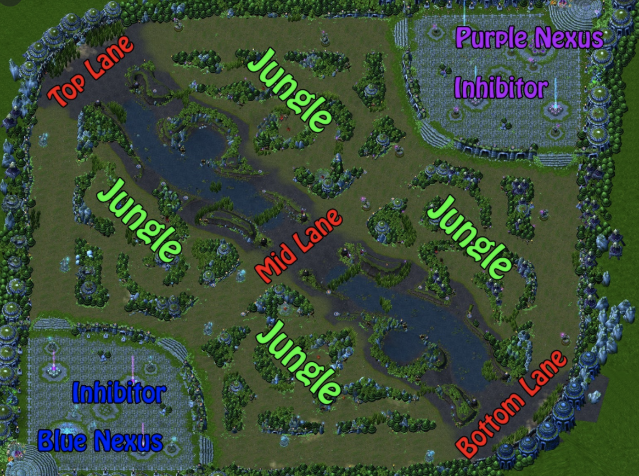
data overview
League of Legends is a MOBA (multiplayer online battle arena) where 2 teams (blue and red) face off. There are 3 lanes, a jungle, and 5 roles. The goal is to take down the enemy Nexus to win the game.
This dataset contains the first 10 min stats of games.
Data columns (total 40 columns) with 9879 entries
No missing value
Goal: predict the outcome of a game base on 10 min statistics
Notes:
add point , to summarad,

Slide 4
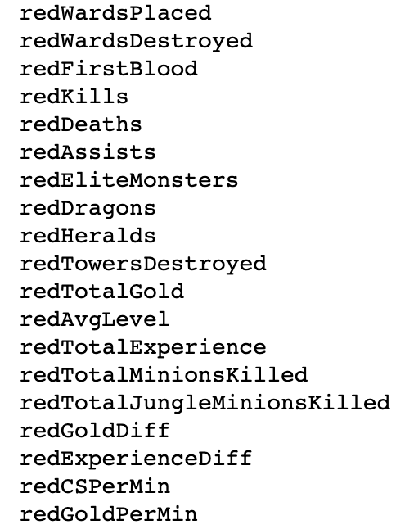
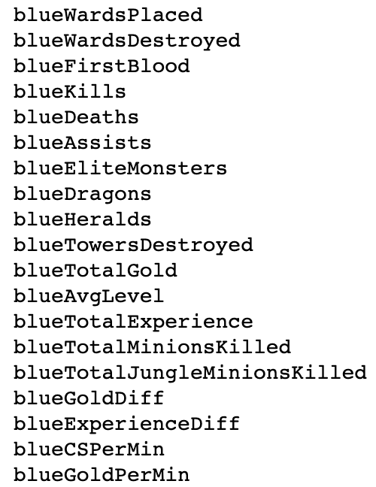
data Overview
Target value: blueWins (the value we are trying to predict). 1 means the blue team has won, 0 otherwise.
gameId: indicate each game is unique. (drop)
There are 19 features per team (38 in total) collected after 10min in-game.
Notes:
Too many feature, next share

Slide 6
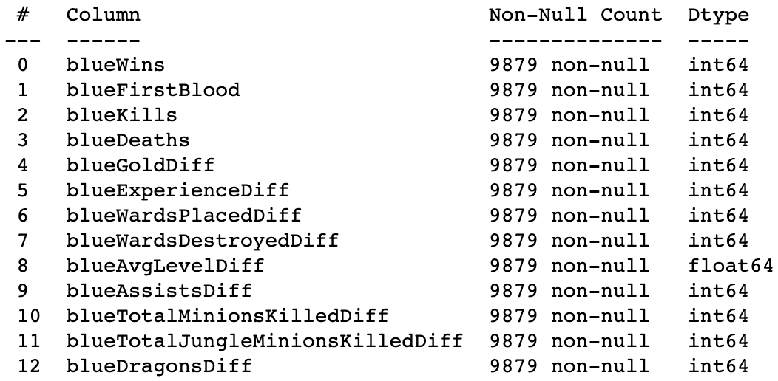
Reformatting the data
Drop out columns which are symmetric and unbalanced, such as redFirstBlood and blueFirstBold, if redFirstBlood is 1, blueFirstBold will be 0, blueKills = redDeaths, redDeaths = blueKills
get the difference between blue team features and red team features by subtracting columns
Notes:
Add table to next slide , fix that aggrea, exclude , demison , scatteplot, add heatmap

Slide 8
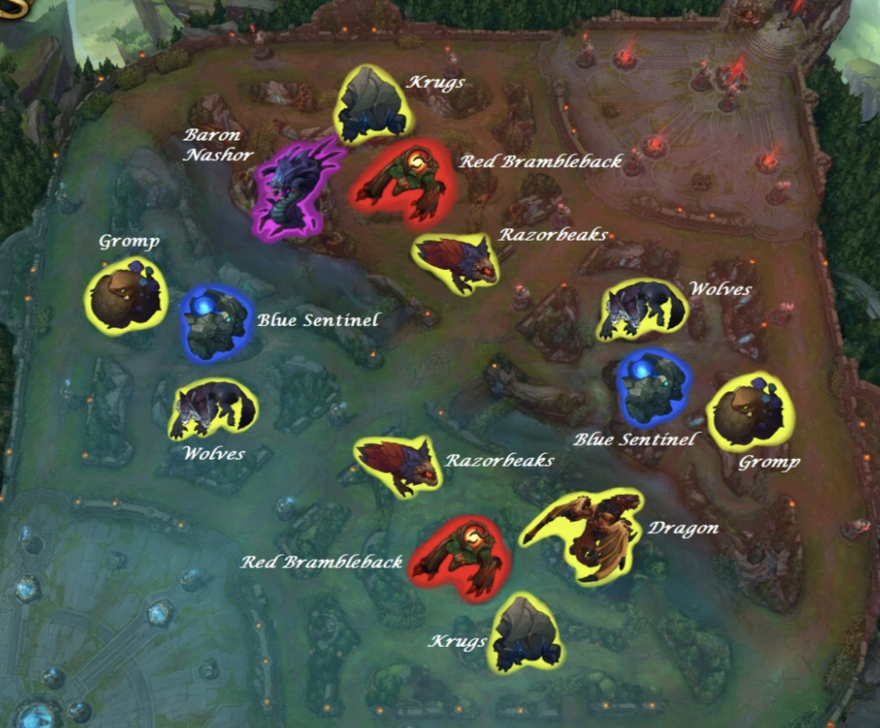
EDA
Base on map design, some players in lol community official forums or Reddit said the blue team has a higher probability to get Heralds and red team get more dragon.
We want to prove whether this statement is true or not.
Notes:
Add data overview describe data, come early ,

Slide 9
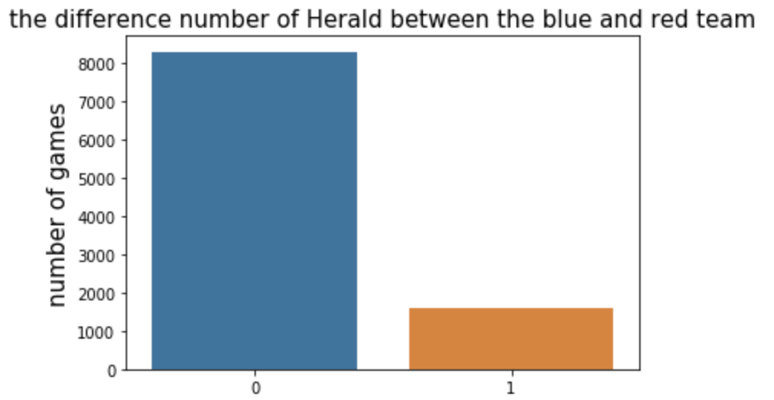
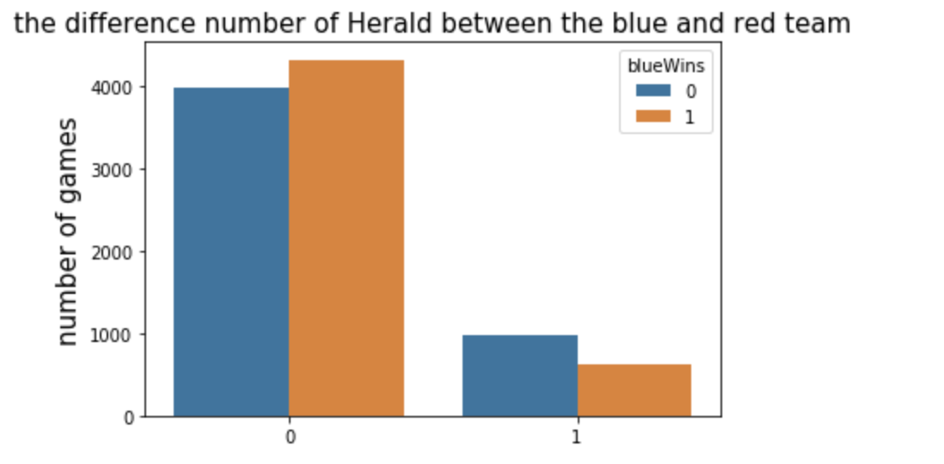
eda
Herald: Elite monster which gives stats bonus when killed by the player. It helps to push a lane and destroys towers
Result: since this is 10 min data, the map only produces 1 Herald in 10 min. the possibility the red team gets the herald in the first 10 min is 0.
But for the blue team gets Herald, it has higher possibility to lose the game.
We might not use this feature into our model since is unbalance and we don’t think it has a strong correlation to predict the game outcome.
Notes:
Label , x , title , legned, empty – 1. the number of heradls

Slide 10
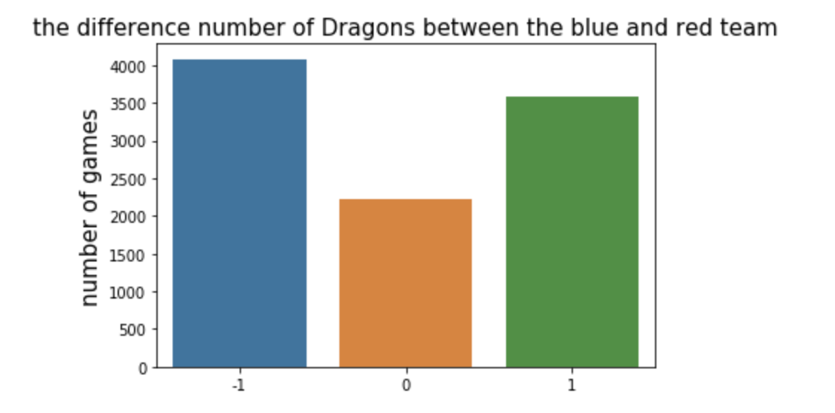
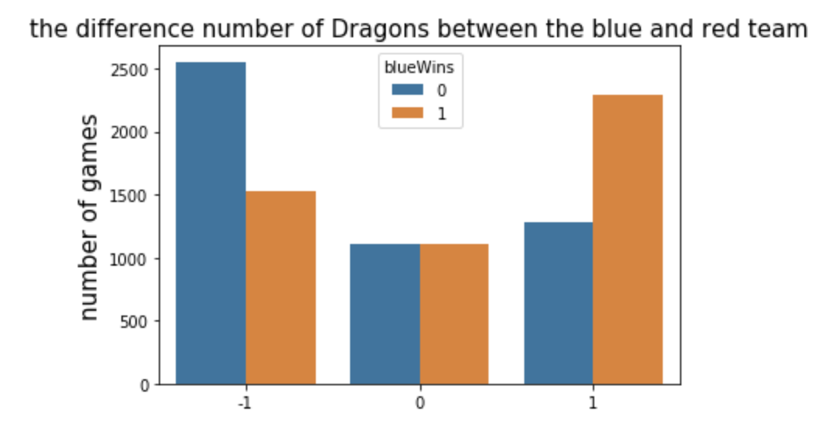
EDA
Dragons: Elite monster which gives team bonus when killed. The 4th dragon killed by a team gives a massive stats bonus. The 5th dragon (Elder Dragon) offers a huge advantage to the team.
Result: the possibility that red team get more dragon in first 10 min is 41.31%, blue team only 36.20%.
Base on graph show, the team which gets more dragons will have a higher possibility to win the game.
We also can prove what people said in the forum base on our data.
Notes:
Add more slide

Slide 11
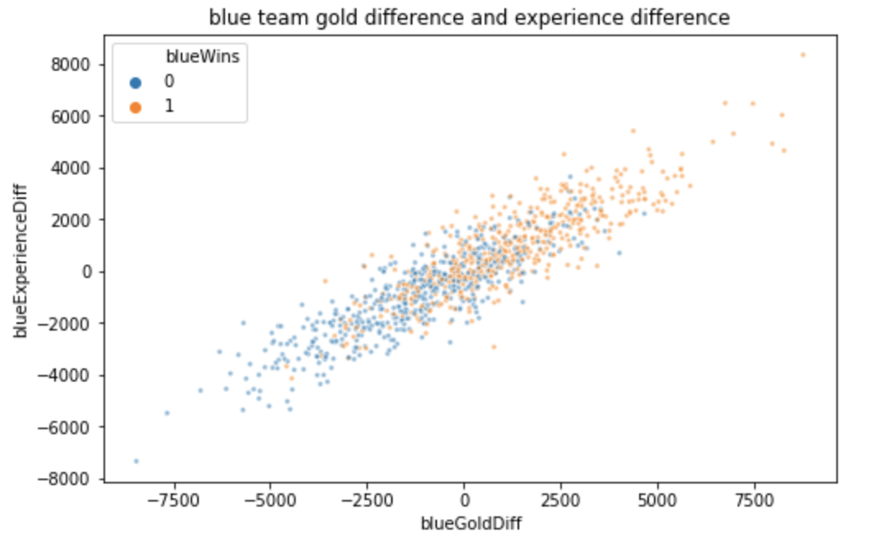
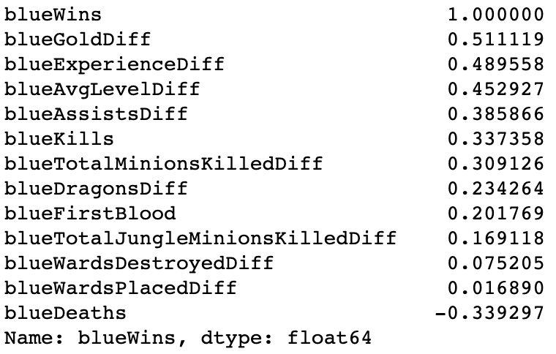
Correlations
As we expect, blueHeradsDiff have negative and weak correlation with target value.
The amount of deaths is one feature has negative correlation with win the game.
Result: Team with more gold and experience would likely to win the game.
Notes:
Look correlation, and scateplot of splo

Slide 12
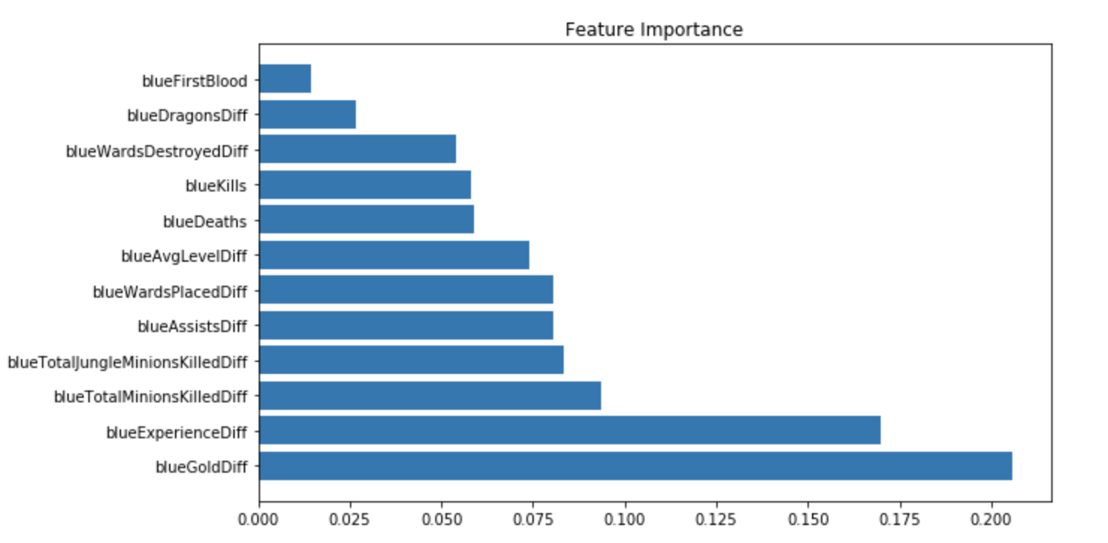
Feature selection
sequential backward selection
tree-based feature selection
selected from model
Notes:
Add algorithm befeorw feature selection , lda, pca, lr may not be one perf well, t v v big ga , overfitting.,

Slide 13
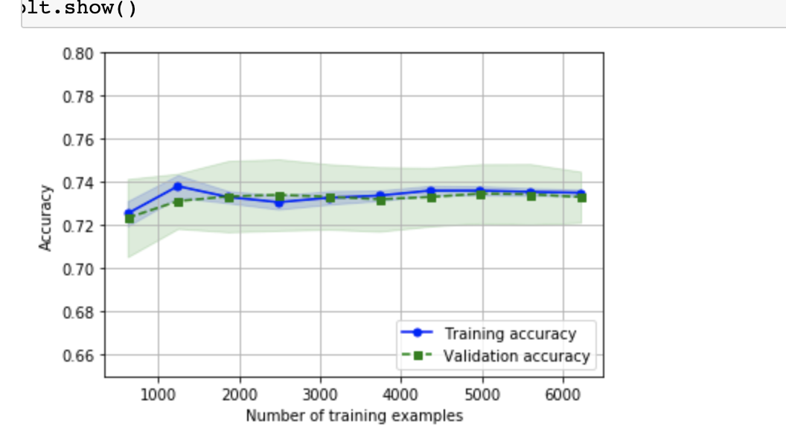
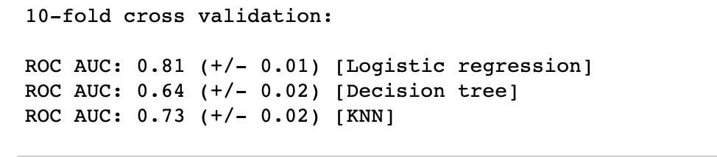
classification

Slide 14
classification

Slide 15
Regression

Slide 16
GitHUB

